Slide 1


<MAYANK RAJ>
<26/08/2026>

Slide 2

Outline
Executive Summary
Introduction
Methodology
Results
Conclusion
Appendix

Slide 3
Executive Summary
Methodology: collected ~90 Falcon 9 launch records (2010-2020) via the SpaceX REST API and Wikipedia web scraping, wrangled and labeled landing outcomes, explored the data with visualization and SQL, built an interactive Folium map and Plotly Dash dashboard, then trained four classification models to predict first-stage landing success.
Results: landing success rose from 0% in 2010-2013 to ~84-90% by 2019-2020; KSC LC-39A (77.3%) and VAFB SLC-4E (76.9%) had the best per-site success rates; low-demand orbits landed 100% of the time vs. 51.9% for GTO; the best tuned classifier reached 87.7% cross-validation accuracy and 83.3% test accuracy.

Slide 4
Introduction
SpaceX advertises Falcon 9 launches at $62 million, versus $165M+ from other providers, largely because it reuses the rocket's first stage instead of discarding it.
If we can predict whether the first stage will land successfully, we can estimate the true cost of a given SpaceX launch — information a competing launch provider could use to bid against SpaceX.
Question this project answers: which pre-launch factors (payload mass, orbit, launch site, booster version, flight history) predict a successful first-stage landing, and how accurately can we predict it?

Slide 5

Section 1

Slide 6
Methodology
Data collection methodology:
  Combined the SpaceX REST API (structured JSON) with Wikipedia web scraping (HTML tables) to assemble launch records
Perform data wrangling
  Filled missing payload-mass values, and labeled each launch Class = 1 (successful landing) or 0 (not)
Perform exploratory data analysis (EDA) using visualization and SQL
Perform interactive visual analytics using Folium and Plotly Dash
Perform predictive analysis using classification models
  Logistic Regression, SVM, Decision Tree and KNN, tuned with GridSearchCV (10-fold CV)

Slide 7
Data Collection
Launch records were assembled from two independent public sources:
SpaceX's public REST API (api.spacexdata.com) — structured JSON per launch covering rocket, payload, launch site and core/landing outcome
Wikipedia's “List of Falcon 9 and Falcon Heavy launches” — an HTML table scraped with BeautifulSoup
Both sources were parsed into pandas DataFrames, filtered to Falcon 9 launches only, and combined into a single ~90-row dataset spanning June 2010 to November 2020

Slide 8
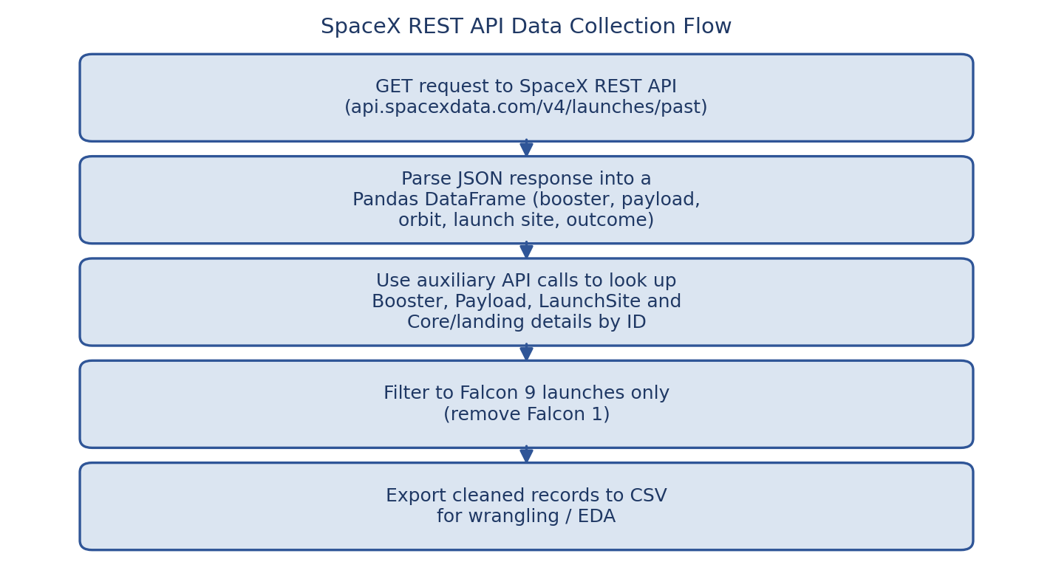
Data Collection – SpaceX API
Sent GET requests to the SpaceX v4 REST API (api.spacexdata.com/v4/launches/past)
Parsed the JSON response into a pandas DataFrame, then used the rocket, payload, launchpad and core IDs to look up booster version, payload mass/orbit, launch-site coordinates and landing outcome via follow-up API calls
Filtered to Falcon 9 launches, filled missing payload-mass values with the column mean, and exported the cleaned records to CSV
GitHub: https://github.com/Mayank98-sudo/SpaceX-Capstone-Project/blob/main/jupyter-labs-spacex-data-collection-api.ipynb

Slide 9
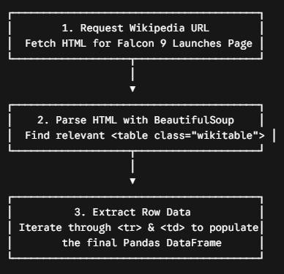
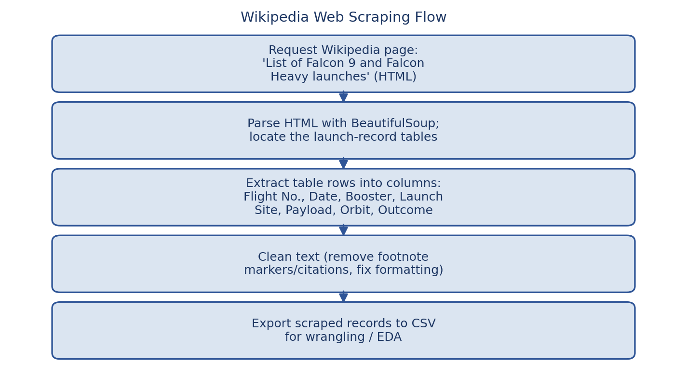
Data Collection - Scraping
Utilized the BeautifulSoup Python library to request and parse Wikipedia HTML tables for historical Falcon 9 launches.
Iterated through table rows (<tr>) and data cells (<td>) to extract raw text data for flight numbers, payload masses, launch sites, and landing outcomes.
GitHub: [add the URL of your completed web-scraping notebook]

Slide 10
Data Wrangling
Counted missing values per column, then filled missing PayloadMass entries with the column mean
Converted the raw landing outcome text into a binary Class label: 1 for a successful landing (ground pad, drone ship, or controlled ocean touchdown), 0 for a failure or no attempt
Kept only Falcon 9 flights and one-hot encoded Orbit, LaunchSite, and Serial for modeling
Result: a clean ~90-row dataset (dataset_part_2.csv) ready for EDA, SQL, and modeling
GitHub: https://github.com/Mayank98-sudo/SpaceXCapstoneProject/blob/9183fd46e228a70595ecb863d8b1195087362e30/labs-jupyter-spacex-Data%20wrangling.ipynb

Slide 11
EDA with Data Visualization
Flight Number vs. Payload Mass / Launch Site / Orbit — scatter plots colored by outcome, to see how launch order, payload mass, and orbit relate to landing success
Payload Mass vs. Launch Site / Orbit Type — scatter plots to see which sites and orbits handle heavier payloads, and whether mass affects landing success
Success rate by Orbit Type — bar chart summarizing which orbits land most reliably
Yearly launch success trend — line chart showing how the success rate improved over time
GitHub: [add the URL of your completed EDA-with-visualization notebook]

Slide 12
EDA with SQL
Listed the unique launch sites, and pulled sample records from the CCAFS pads
Summed NASA (CRS) payload mass and averaged F9 v1.1 payload mass
Found the date of the first successful ground-pad landing
Identified boosters that landed successfully on a drone ship with a 4,000-6,000 kg payload
Counted successful vs. failed outcomes, and found the booster(s) that carried the maximum payload
Pulled 2015 drone-ship landing failures, and ranked landing-outcome counts for 2010-2017
GitHub:https://github.com/Mayank98sudo/SpaceXCapstoneProject/blob/9183fd46e228a70595ecb863d8b1195087362e30/jupyter-labs-eda-sql-coursera_sqllite.ipynb

Slide 13
Build an Interactive Map with Folium
Added an orange Circle plus a text-label Marker at each of the 4 launch-site coordinates, on a folium.Map centered on NASA Johnson Space Center
Added a MarkerCluster with one green (success) or red (failure) circle marker per individual launch, so per-site outcome patterns are visible at a glance
Enabled MousePosition and drew PolyLine distance markers from a launch site to the nearest coastline, railway and highway, to test proximity to transport routes and the coast
These map elements make it easy to see that sites are coastal, near the equator, and set back from cities — confirmed on the following slides
GitHub: [add the URL of your completed Folium-map notebook]

Slide 14
Build a Dashboard with Plotly Dash
Dropdown to switch between “All Sites” and each individual launch site
Pie chart of total successful launches by site (All Sites view) or the success-vs-failure split for the selected site — to compare reliability across pads at a glance
Payload-mass range slider (0-9,600 kg) driving a Payload vs. Launch Outcome scatter plot colored by booster version — to explore how payload mass and booster generation relate to landing success, interactively
These interactions let a user drill from a fleet-wide view down to a single site's payload/outcome relationship in a few clicks
GitHub: [add the URL of your completed Plotly Dash app]

Slide 15
Predictive Analysis (Classification)
Standardized the features (StandardScaler) and split into 80% train / 20% test (18 held-out launches, random_state=2)
Tuned 4 classifiers with GridSearchCV (10-fold cross-validation): Logistic Regression, SVM, Decision Tree, and KNN
How to build, tune, evaluate classification models
Compared cross-validation accuracy to pick the best hyperparameters for each model, then validated all 4 on the untouched test set and via a confusion matrix
Decision Tree had the strongest cross-validation accuracy (87.7%); all 4 tuned models tied at 83.3% on the small 18-launch test set
GitHub: [add the URL of your completed predictive-analysis notebook]

Slide 16
Results
Exploratory data analysis results
Landing success climbed from 0% (2010-2013) to ~84-90% (2019-2020); KSC LC-39A (77.3%) and VAFB SLC-4E (76.9%) out-performed CCAFS SLC-40 (60%); low-risk orbits (SSO/GEO/HEO/ES-L1) landed 100% of the time vs. 51.9% for GTO
Interactive analytics demo in screenshots
The Folium map confirms all 4 sites sit near the coast and close to the equator; the Dash dashboard shows KSC LC-39A contributing the largest share (41.7%) of successful launches
Predictive analysis results
Tuned classifiers reached up to 87.7% cross-validation accuracy and 83.3% test accuracy at predicting landing outcome

Slide 17

Section 2

Slide 18
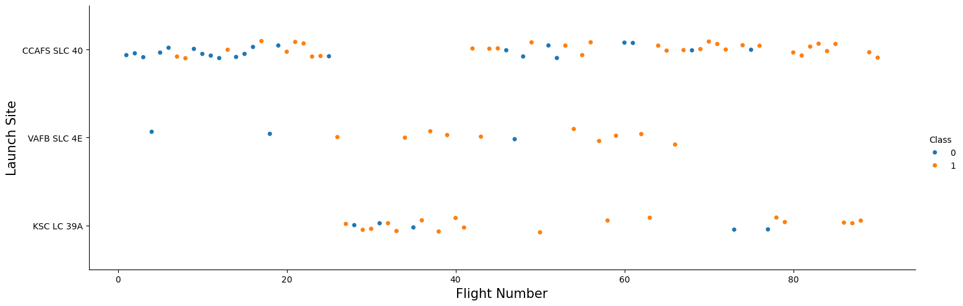
Flight Number vs. Launch Site
Later flights (higher flight numbers) land successfully far more often than early ones — first-stage recovery was still experimental in 2010-2014, and reliability climbed steadily as SpaceX iterated on the Falcon 9 design.

Slide 19
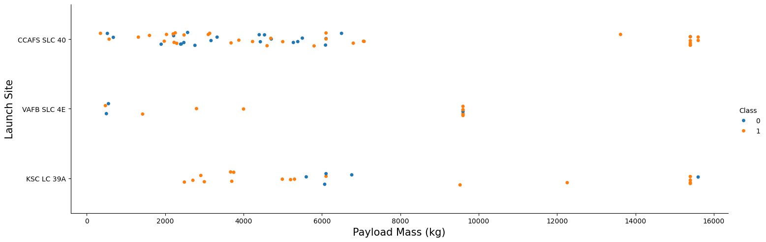
Payload vs. Launch Site
CCAFS SLC-40 handles by far the widest range of payload masses, including the heaviest (~15,600 kg); VAFB SLC-4E is used mainly for polar/sun-synchronous orbits, so its payloads cluster in a narrower, lighter band.

Slide 20
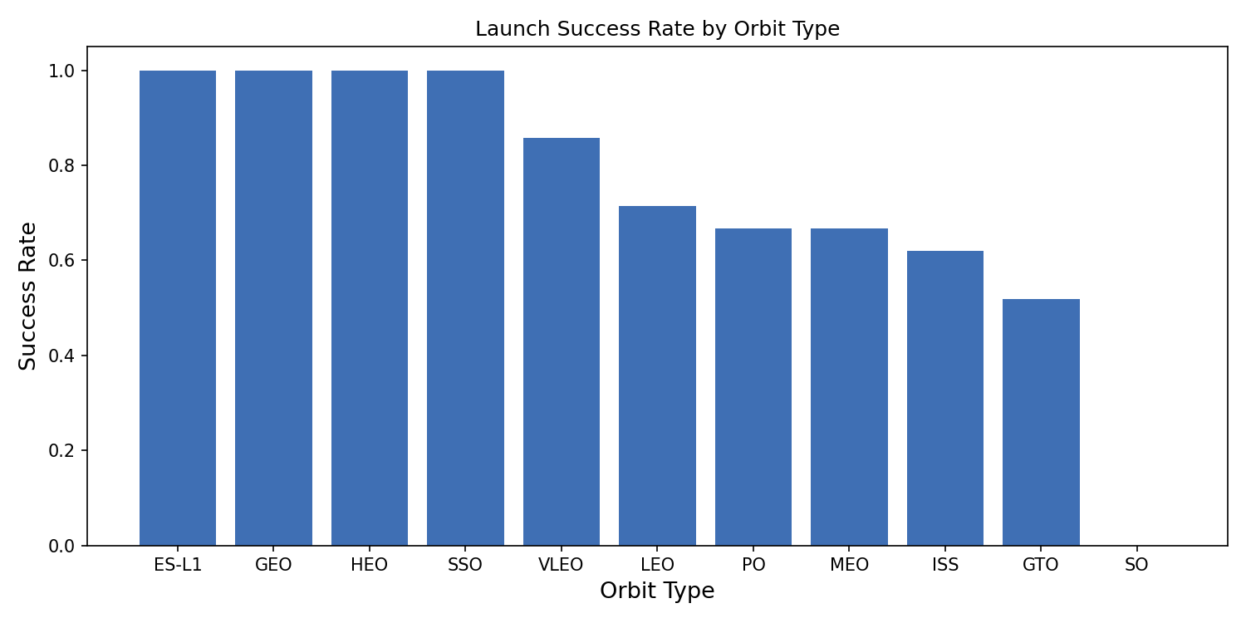
Success Rate vs. Orbit Type
ES-L1, GEO, HEO and SSO orbits landed successfully 100% of the time (on small sample sizes); VLEO landed 85.7% of the time; GTO — the most common and most demanding orbit — had the lowest success rate at 51.9%.

Slide 21
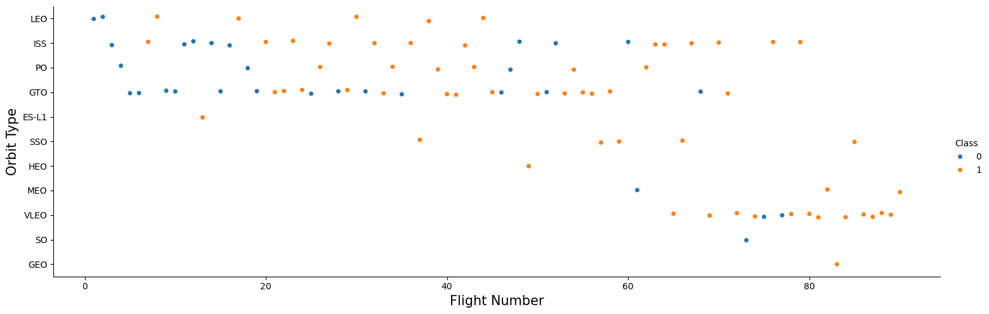
Flight Number vs. Orbit Type
Early flights (low flight numbers) were concentrated in GTO and ISS orbits and failed often; from roughly flight 50 onward, SpaceX flew a wider mix of orbits, including VLEO, with mostly successful landings.

Slide 22
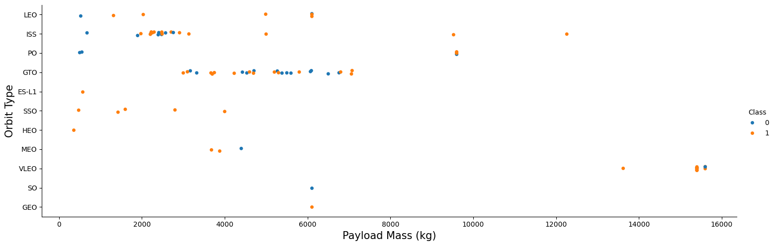
Payload vs. Orbit Type
GTO carries the widest spread of payload masses and mixes both outcomes; VLEO payloads are heavy (13,000-15,600 kg) and land successfully almost every time, reflecting a matured, reusable booster fleet by the time VLEO missions began.

Slide 23
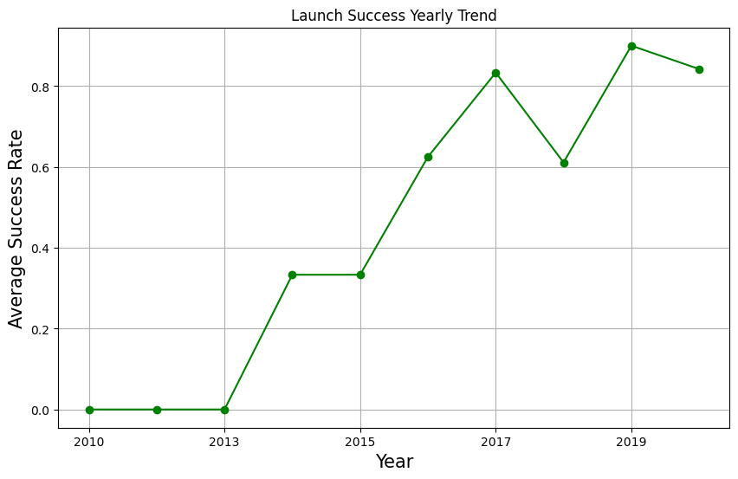
Launch Success Yearly Trend
Success rate was 0% in 2010, 2012 and 2013, rose to 33% in 2014-2015, passed 60% by 2016, and reached 90% in 2019 before easing slightly to 84% in 2020 — a clear, steady improvement as SpaceX refined first-stage recovery.

Slide 24
All Launch Site Names
Query: SELECT DISTINCT "Launch_Site" FROM SPACEXTABLE;
Result: CCAFS LC-40, CCAFS SLC-40, KSC LC-39A, VAFB SLC-4E
Four unique launch sites appear in the dataset: two Cape Canaveral pads (the original LC-40 and its rebuilt successor SLC-40), Kennedy Space Center's historic LC-39A, and Vandenberg's SLC-4E on the California coast.

Slide 25
Launch Site Names Begin with 'CCA'
Query: SELECT * FROM SPACEXTABLE WHERE "Launch_Site" LIKE 'CCA%' LIMIT 5;
Result: 5 earliest CCAFS LC-40 launches (2010-06-04 to 2013-03-01) — boosters B0003-B0007, payloads from 0 to 677 kg
All 5 predate SpaceX's landing program: every landing outcome reads “Failure (parachute)” or “No attempt,” since recovery wasn't yet being attempted.

Slide 26
Total Payload Mass
Query: SELECT SUM("PAYLOAD_MASS__KG_") FROM SPACEXTABLE WHERE "Customer" LIKE '%NASA (CRS)%';
Result: 45,596 kg
Across all Commercial Resupply Services missions flown for NASA, SpaceX has delivered roughly 45.6 metric tons of cargo to the ISS.

Slide 27
Average Payload Mass by F9 v1.1
Query: SELECT AVG("PAYLOAD_MASS__KG_") FROM SPACEXTABLE WHERE "Booster_Version" = 'F9 v1.1';
Result: 2,534 kg
The early F9 v1.1 booster (flown 2013-2016) averaged about 2,534 kg per payload — far below the 15,000+ kg the current fleet routinely carries, reflecting that generation's smaller payload capacity.

Slide 28
First Successful Ground Landing Date
Query: SELECT MIN("Date") FROM SPACEXTABLE WHERE "Landing_Outcome" = 'Success (ground pad)';
Result: 2015-12-22
SpaceX achieved its first successful ground-pad landing on 22 December 2015 (Orbcomm-2 mission, booster B1019) — the milestone that proved first-stage reuse was viable.

Slide 29
Successful Drone Ship Landing with Payload between 4000 and 6000
Query: SELECT "Booster_Version" FROM SPACEXTABLE WHERE "Landing_Outcome" = 'Success (drone ship)' AND "PAYLOAD_MASS__KG_" BETWEEN 4000 AND 6000;
Result: F9 FT B1022, F9 FT B1026, F9 FT B1021.2, F9 FT B1031.2
Four Falcon 9 Full Thrust boosters successfully landed on a drone ship while carrying a mid-weight (4-6 t) payload — including B1021, the first-ever orbital-class booster to be reflown.

Slide 30
Total Number of Successful and Failure Mission Outcomes
Query: SELECT "Mission_Outcome", COUNT(*) FROM SPACEXTABLE GROUP BY "Mission_Outcome";
Result: only 1 mission failure logged (CRS-7, which broke apart in flight in June 2015) out of >100 Falcon 9 missions — the rest are “Success.”
Mission outcome (did the payload reach orbit) is far more reliable than landing outcome (did the booster land) — the two are tracked, and fail, independently.

Slide 31
Boosters Carried Maximum Payload
Query: SELECT "Booster_Version" FROM SPACEXTABLE WHERE "PAYLOAD_MASS__KG_" = (SELECT MAX("PAYLOAD_MASS__KG_") FROM SPACEXTABLE);
Result: 15,600 kg, carried repeatedly by 6 flight-proven Block 5 boosters (B1048, B1049, B1051, B1056, B1058, B1060, across their .2-.7 reflights)
Reused boosters clearly handle SpaceX's heaviest payloads just as well as new ones — strong evidence for the reusability program's maturity.

Slide 32
2015 Launch Records
Query: month names + failed drone-ship landings, booster versions and launch sites for 2015
Result: F9 v1.1 B1012 (CCAFS LC-40, Jan 2015) and F9 v1.1 B1015 (CCAFS LC-40, Apr 2015) — both “Failure (drone ship)”
Both of 2015's drone-ship landing attempts failed — recovery was still experimental, months before the first successful ground-pad landing that December.

Slide 33
Rank Landing Outcomes Between 2010-06-04 and 2017-03-20
Query: landing-outcome counts between 2010-06-04 and 2017-03-20, ranked descending
Result: No attempt 10 · Failure (drone ship) 5 · Success (drone ship) 5 · Controlled (ocean) 3 · Success (ground pad) 3 · Failure (parachute) 2 · Uncontrolled (ocean) 2 · Precluded (drone ship) 1
In SpaceX's first ~7 years, a third of launches made no recovery attempt at all, and drone-ship attempts split evenly between success and failure — landing on a moving ocean platform was the hardest, least mature part of the program.

Slide 34

Section 3

Slide 35
Global View of All Launch Site Locations
Added an orange Circle (1 km radius) plus a text-label Marker at each of the 4 launch-site coordinates, on a folium.Map centered on NASA Johnson Space Center
All 4 sites cluster on the US Gulf/Atlantic coast (Florida) or Pacific coast (California) — confirming rockets launch near the coast, so spent stages fall over open ocean, and reasonably close to the equator for an eastward speed boost
[Insert your own screenshot of the generated Folium map here, showing all 4 site markers]

Slide 36
Launch Outcomes by Site (Color-Coded Markers)
Used a MarkerCluster with one colored circle marker per launch — green for a successful landing, red for a failure — so nearby launches at the same site don't overlap
KSC LC-39A and VAFB SLC-4E clusters show mostly green markers, while CCAFS SLC-40 shows a more even green/red mix, matching the 77.3%, 76.9% and 60% site success rates computed in the SQL and dashboard sections
[Insert your own screenshot of the color-coded marker-cluster map here]

Slide 37
CCAFS SLC-40 Proximity to Coastline and Infrastructure
Enabled MousePosition to read off coordinates, then drew PolyLines with distance labels from CCAFS SLC-40 (28.5632°N, -80.5768°W) to the nearest coastline point, railway and highway
The pad sits under 1 km from the coast (for safe over-ocean aborts) but several kilometers from the nearest city — confirming SpaceX balances easy logistics access against public-safety setback distances
[Insert your own screenshot of the site-to-coastline distance markers here]

Slide 38

Section 4

Slide 39
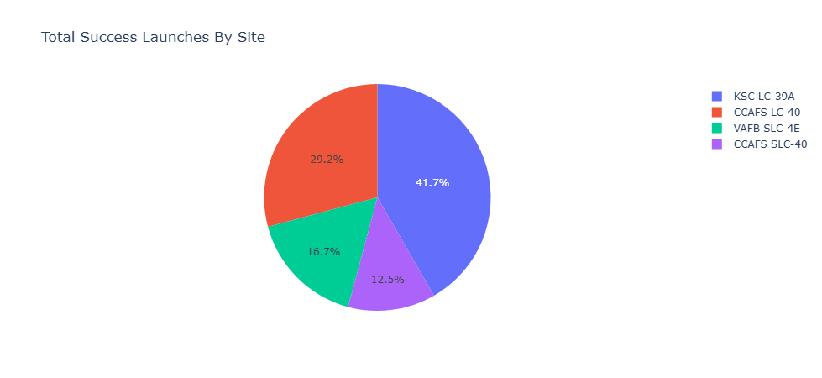
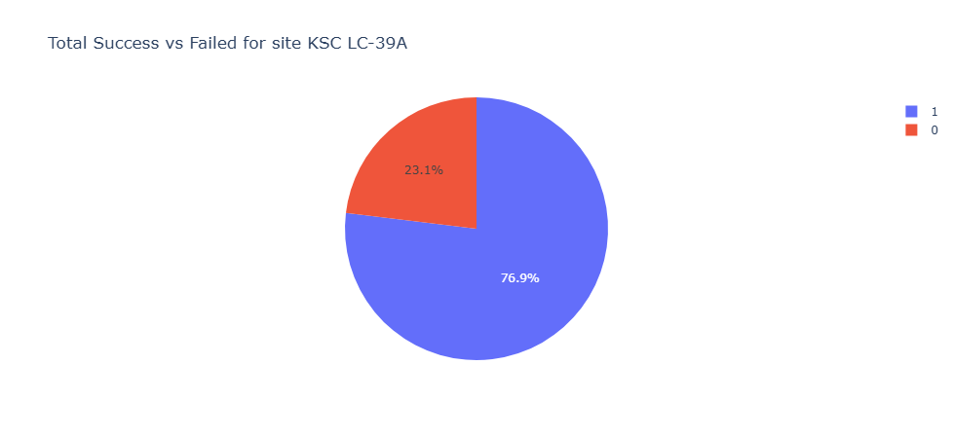
Launch Success Count by Site (All Sites)
Pie chart with the “All Sites” dropdown selection, showing each site's share of total successful launches
KSC LC-39A leads with 41.7% of all successful launches, followed by CCAFS LC-40 (29.2%), VAFB SLC-4E (16.7%) and CCAFS SLC-40 (12.5%).

Slide 40
Success vs. Failure for the Top Site (KSC LC-39A)
Pie chart after selecting KSC LC-39A — the individual site with the highest launch-success ratio
76.9% of KSC LC-39A launches succeeded vs. 23.1% failed — the best ratio of any individual pad.

Slide 41
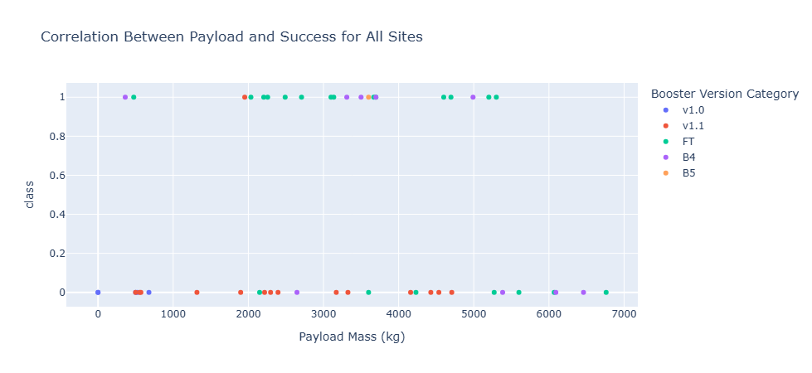
Payload vs. Launch Outcome, by Payload Range
Scatter of Payload Mass vs. launch-outcome class, colored by booster version, filtered live by the payload-mass range slider
Newer FT/B4/B5 boosters land successfully far more consistently than early v1.0/v1.1 versions, across all payload levels.

Slide 42

Section 5

Slide 43
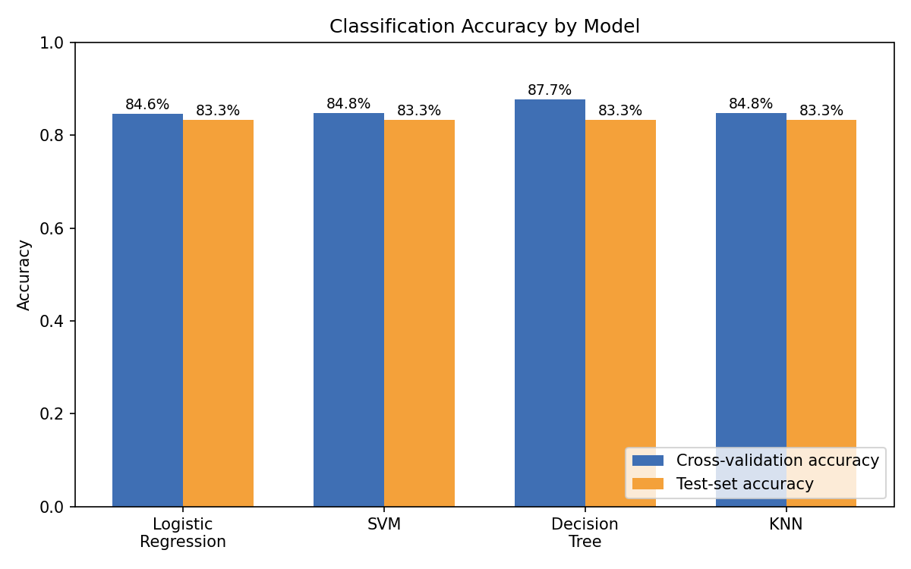
Classification Accuracy
Compared 4 tuned classifiers via 10-fold cross-validation: Decision Tree 87.7%, SVM 84.8%, KNN 84.8%, Logistic Regression 84.6%
On the 18-launch held-out test set, all 4 tuned models tied at 83.3% accuracy — Decision Tree had the edge in cross-validation and is the recommended model overall

Slide 44
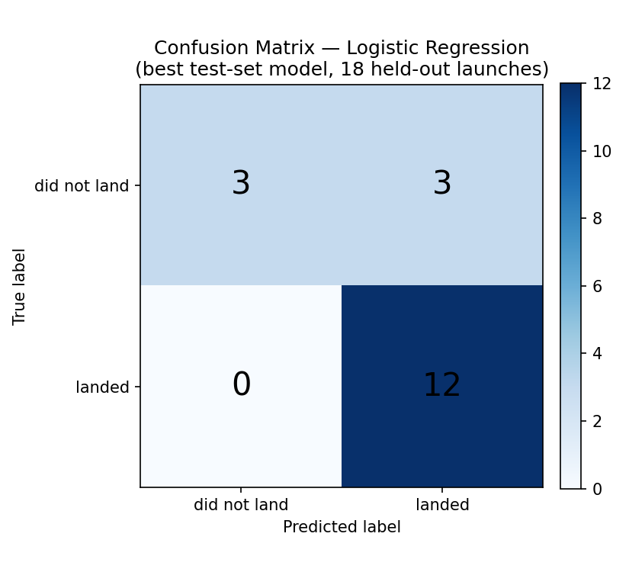
Confusion Matrix
Confusion matrix for the best test-set model (Logistic Regression) on the 18 held-out launches.
12 true landings and 3 non-landings correctly predicted; 3 false positives; 0 false negatives.
The model's main weakness is over-predicting successful landings.

Slide 45
Conclusions
Landing success climbed from 0% (2010-2013) to ~84-90% (2019-2020) as SpaceX matured its first-stage recovery process
Launch site, orbit type and payload mass all measurably affect landing success — KSC LC-39A and VAFB SLC-4E outperform CCAFS SLC-40, and low-demand orbits land far more reliably than GTO
A tuned classifier (Decision Tree / Logistic Regression) predicts landing outcome with ~83-88% accuracy from pre-launch features alone (payload, orbit, site, booster, flight count)
This means launch cost — and therefore a competing bid — can be estimated in advance with reasonable confidence, just from a mission's public profile
Next steps: add more recent launches (the fleet is now predominantly Block 5) and booster-refurbishment-count features to sharpen the model further

Slide 46
Appendix
Notebooks: data collection (API), web scraping, data wrangling, EDA (SQL + visualization), interactive Folium map, Plotly Dash dashboard, and classification (Part 5) — [add your GitHub repo URL(s) here]
All EDA and dashboard chart images in this deck were generated from dataset_part_2.csv (90 Falcon 9 launches, 2010-2020)
The SQL queries and Python snippets referenced throughout this deck are available in the linked notebooks

Slide 47
